Slide 1
Course Name : Data Structures & Algorithms
Bharat Deshpande
Computer Science & Information Systems

Slide 2
Hash Tables
Aim
To develop a search procedure with running time O(1).
Array is an immediate answer.
Example: Consider a sorted sequence stored in an array.
Focus on finding 44.
Binary search does it in O(logn) time
Can we retrieve faster than binary search?
11 | 22 | 28 | 33 | 44 | 49 | 55 | 58 | 66 | 77 | 79 | 88

Slide 3
Hash Tables
If 44 was stored in A[44], search would be done in one
step.
Problem is if keys are very large.
Lot of cells will be empty and so inefficient in terms of
space requirement.
Answer : Hash Tables
Uses an array of size proportional to the number of
keys used.
Instead of using key as an array index, array index is
computed from the key.

Slide 4
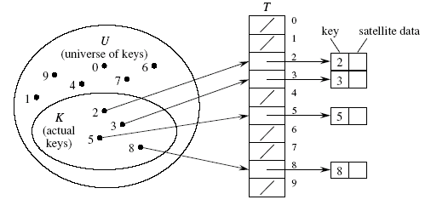
Array as table
It is also called Direct-address Hash Table.
• Each slot, or position, corresponds to a key in U.
• If there’s an element x with key k, then T [k] contains a pointer to x.
• Otherwise, T [k] is empty, represented by NIL.

Slide 5
Array as table
Store the records in a huge array where the index corresponds to the key
add - very fast O(1)
delete - very fast O(1)
search - very fast O(1)

Slide 6
Direct Address table
Disadvantage of Direct Address table
If the universe U is very large, storing a table of size |U| may be impractical.
The set K of keys actually stored may be small relative to U, so that most of the space allocated for table is wasted.

Slide 7
Hash function
In direct addressing, an element with key k is stored in slot k.
With hashing, the hash function is used to compute the slot h(k)
h : U → {0, 1,….,m-1}
We say that h(k) is the hash value of k.
Aim
To reduce the range of array of indices that needs to be handled

Slide 8
Compression Maps
Division Method
h(k) = k mod m
Certain values of m may not be good:
Good values for m are prime numbers which are not close to exact powers of 2. For example, if you want to store 2000 elements then m=701 (m = hash table length) yields a hash function: h(k) = k mod 701

Slide 9
Compression Maps
MAD Method (Multiply, Add and Divide)
Define h(k) = (ak +b) mod n,
where n is a prime number and a and b are
chosen randomly so that a mod n ≠ 0.
This function is chosen in order to eliminate repeated patterns.

Slide 10
Hash function
Problem:
Two keys may hash to the same slot – collision
Ideal situation – avoid collision altogether
But it is generally difficult to design perfect
hash. (e.g. when the potential key space is large)
Solution :
Find effective techniques for resolving collision

Slide 11
Collision Resolving
Collision resolution by chaining
In chaining, we put all elements that hash to same slot in a linked list.
Slot j contains a pointer to the head of the list of all stored elements that hash to j
• If there are no such elements, slot j contains NIL.

Slide 12
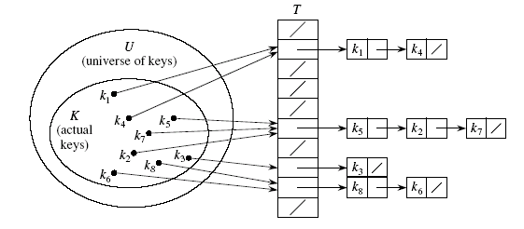
Chained Hash Table

Slide 13
Performance Analysis
Worst Case
All keys are hashed to the same slot, worst cast
is O(n) time
Average Performance
Given a hash table T with m slots that stores n
keys,
Define load factor α for T as n/m
- average keys per slot.

Slide 14
Performance Analysis
Assume
Simple uniform hashing.
Any key is equally likely to hash into any of the m slots, independent of where any other key hashes to.
O(1) time to compute h(k).
Time to search for an element with key k depends linearly on the length of the list T[h(k).
Expected length of a linked list = load factor = α = n/m.
We consider two cases:
Unsuccessful search
Successful search

Slide 15
Unsuccessful Search
Theorem:
An unsuccessful search takes expected time Θ(1+α).
Proof:
Any key not already in the table is equally likely to hash to any of the m slots.
To search unsuccessfully for any key k, need to search to the end of the list T[h(k)], whose expected length is α.
Adding the time to compute the hash function, the total time required is Θ(1+α).

Slide 16
Successful Search
Theorem:
A successful search takes expected time Θ(1+α).
Proof:
The probability that a list is searched is proportional to the number of elements it contains.
Assume that the element being searched for is equally likely to be any of the n elements in the table.
The number of elements examined during a successful search for an element x is 1 more than the number of elements examined when the sought for element was inserted.
The expected length of list to which the ith element is added is
(i-1)/m

Slide 17
Expected Cost of a Successful Search
Proof contd.
Therefore, the expected no. of elements examined in a
successful search is
It can be shown that this is of order Θ(1+α).

Slide 18
Expected Cost – Interpretation
If n = O(m), then α=n/m = O(m)/m = O(1).
⇒ Searching takes constant time on average.
Insertion is O(1) in the worst case.
Deletion takes O(1) worst-case time when lists are doubly linked.
Hence, all dictionary operations take O(1) time on average with hash tables with chaining.

